Slide 1
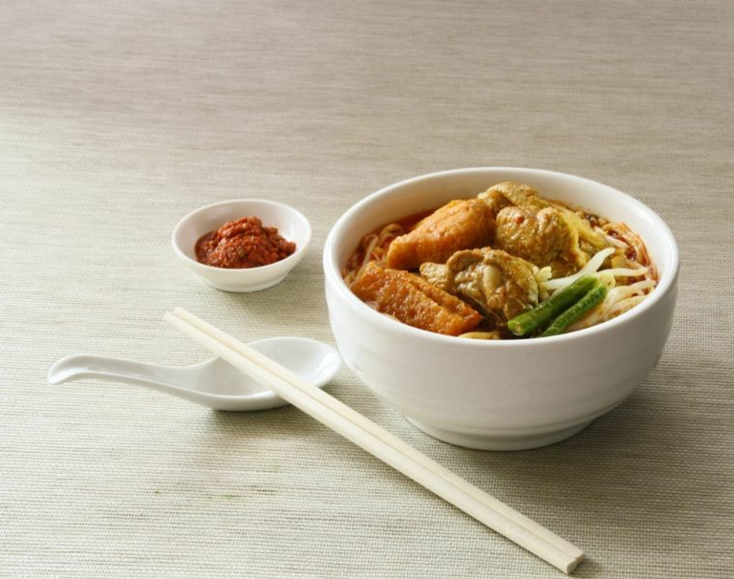
SC 1015 Mini-Project
Adil Hasan,
Syed Muhammad Irfan bin Ameer Hamza,
Syed Hidir bin Syed Haron

Slide 2
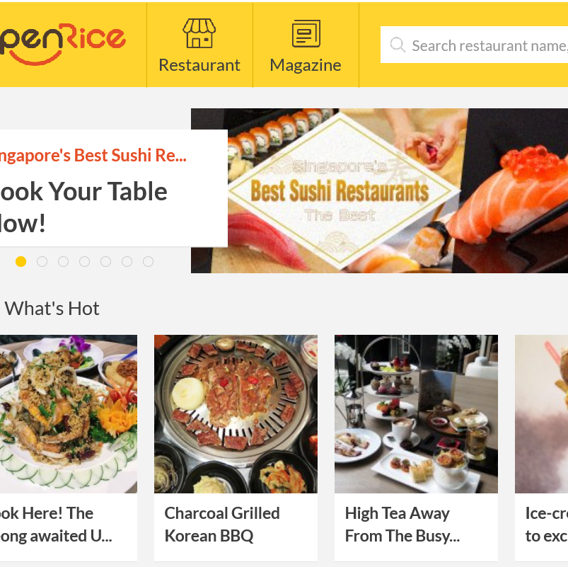
Sample Collection and Practical Motivation
Dataset: Details of thousands of Singapore restaurants, scraped (through Internet Archive) and parsed from SG OpenRice.
Price, Rating, Location, Cuisines
What are some interesting problems using this?

Slide 3
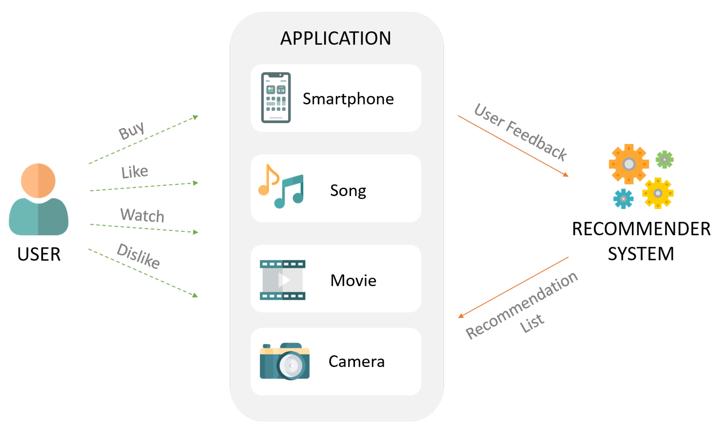
Sample Collection and Practical Motivation
Problem Space: Recommender Systems
Used or seen by us every day.
Examples include targeted ads and various social media apps.
They often use collaborative filtering; our data doesn’t allow it.

Slide 4
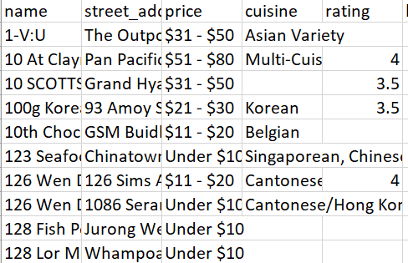
Data Preparation and Problem Formulation
Clear problem statement.
Novel and Interesting recommendation based only on OpenRice data and the history of the user we’re recommending for.
In some important way different from their past choices
To avoid culture shock, otherwise similar to past choices.

Slide 5
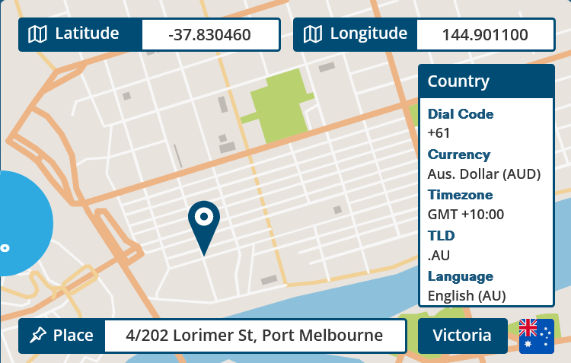
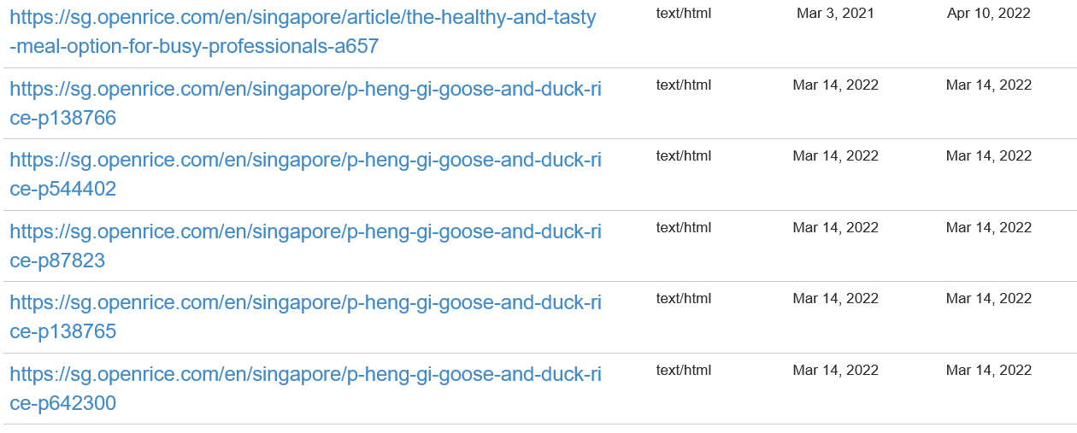
Data Preparation and Problem Formulation
SG OpenRice servers not scraping-friendly.
Instead, used Internet Archive as mirror.
Parsed in Python (BeautifulSoup lib).
Then street addresses to GPS using PositionStack API.

Slide 6
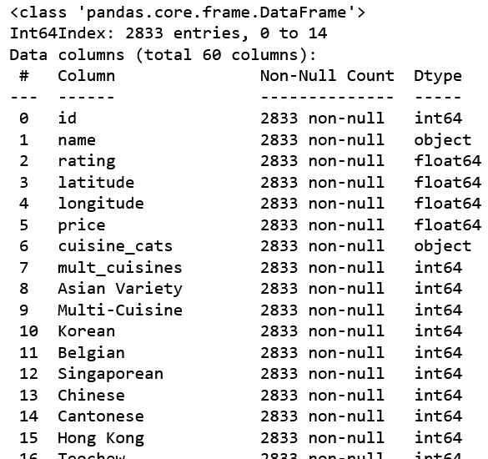
Data Preparation and Problem Formulation
Features (name, address, GPS, price, rating, cuisines) in raw form after parsing, needed cleaning in Jupyter.
Remove duplicated, missing price, address, or GPS.
1500 missing ratings – replaced with mode.
Parse cuisines – 52 cuisines, each restaurant has multiple, turned into individual columns.

Slide 7
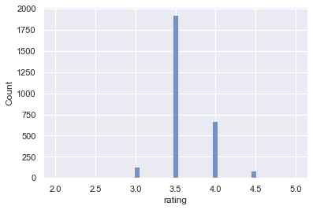
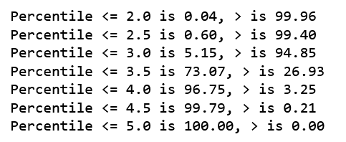
Exploratory Analysis and Statistical Description
Ratings almost all (90+%) 3.5 or 4.0, usefulness thus limited.
0.60% at 2.5 or lower, 0.21% score 5.0.

Slide 8
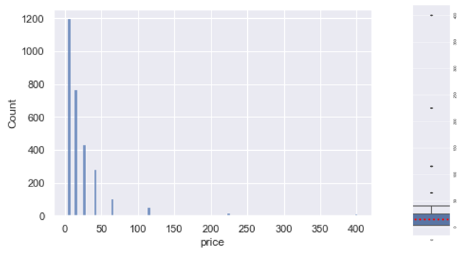
Exploratory Analysis and Statistical Description
Price is “shifted exponential” distribution.
Central tendency very far towards the minimum.

Slide 9
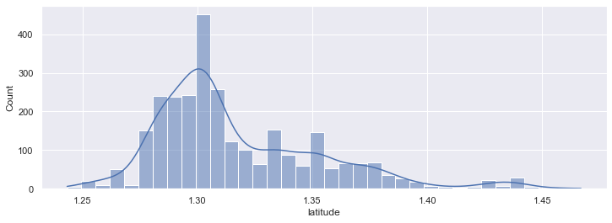
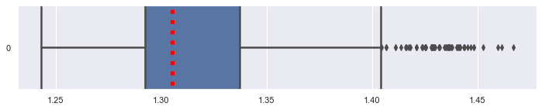
Exploratory Analysis and Statistical Description
Latitude is strongly positively skewed.
Thick tail and many outliers to the north, small 2nd peak.
Insight: Large agglomeration of restaurants to the south of SG, smaller clumps to the north.

Slide 10
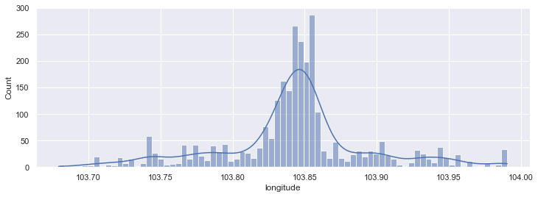
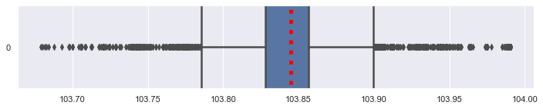
Exploratory Analysis and Statistical Description
Longitude, meanwhile has very thick tail on both ends.
Insights regarding location
On horizontal axis, Singapore has many restaurants both east and west of the centre.
On vertical axis, large agglomeration of restaurants to the south of SG, then smaller clumps to the north.

Slide 11
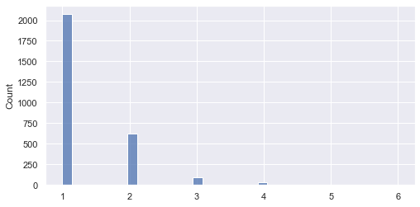
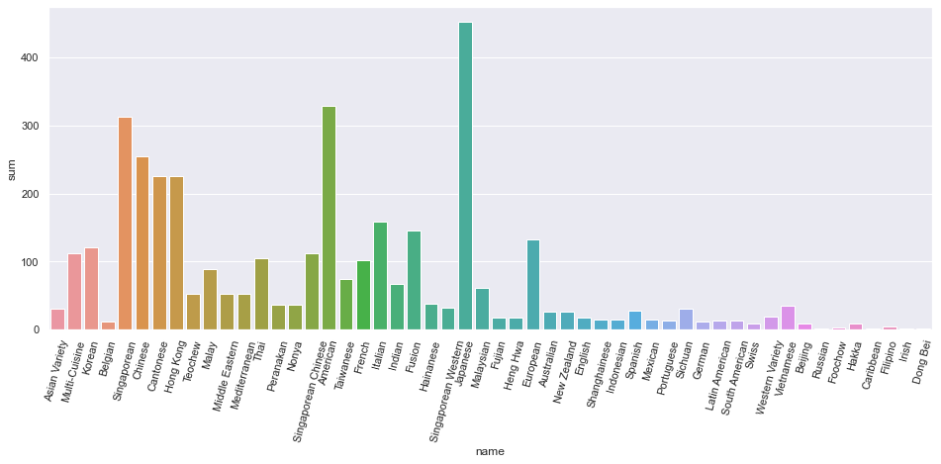
Exploratory Analysis and Statistical Description
Cuisines not at all evenly distributed, a few cuisines are very popular.
Restaurants can have multiple cuisines.
One or two cuisine restaurants most frequent.
Few three-cuisine, very few 4-6 cuisine.

Slide 12
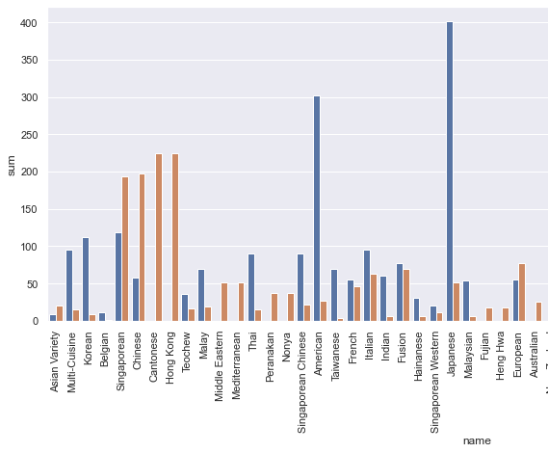
Exploratory Analysis and Statistical Description
Plotted for each cuisine the number of corresponding monocuisine vs multi-cuisine restaurants.
Insights
Very varied. Most cuisines found more often on their own, Singaporean and Chinese tend to be with others.
Cantonese and Hong Kong almost never alone, is because they usually go together.

Slide 13
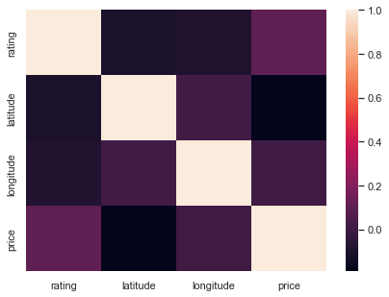
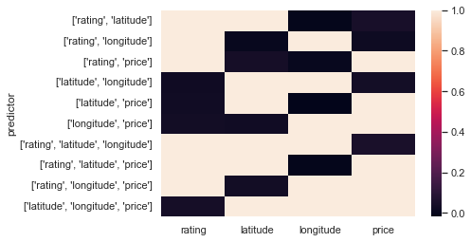
Exploratory Analysis and Statistical Description
No clear linear relationships.

Slide 14
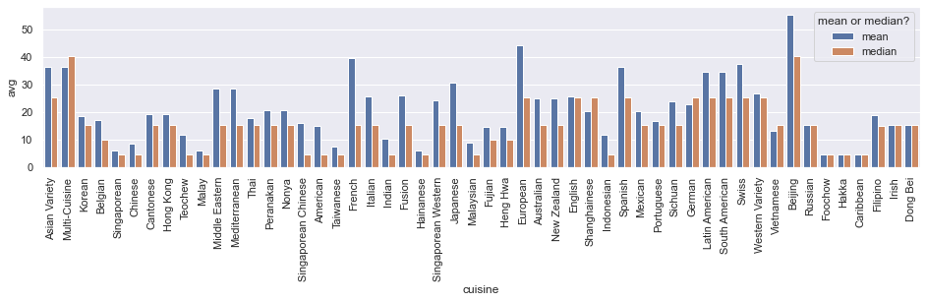
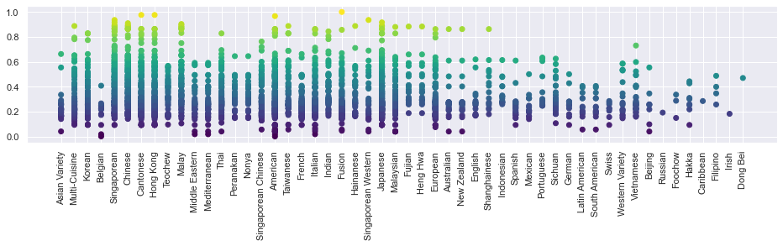
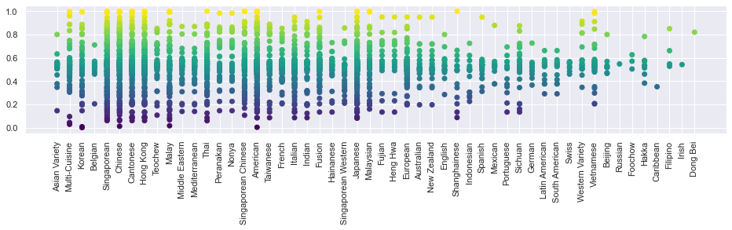
Exploratory Analysis and Statistical Description
A lot of connection between price and cuisine.
Distribution of latitudes and longitudes varies with cuisine.
Central tendency of latitudes also varies with cuisine.

Slide 15
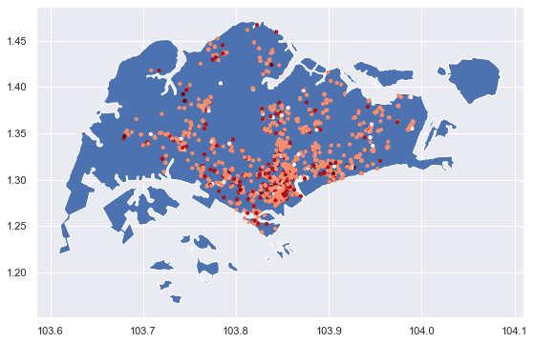
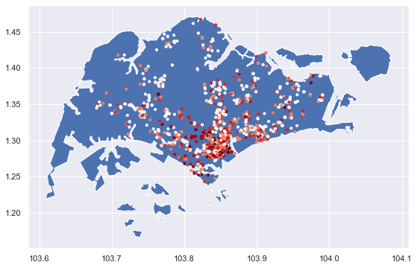
Exploratory Analysis and Statistical Description
Complex clumping observed when price and rating plotted geographically as coloured points on Singapore map using latitude and longitude

Slide 16
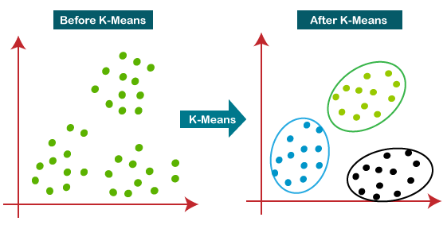
Exploratory Analysis and Statistical Description
Verdict: Complex nonlinear relationships make clustering a good approach for finding restaurants “In some important way different from [user’s] past choices”.

Slide 17
Algorithmic Optimization and Machine Learning
So we’ve decided to use clustering – many clustering algorithms.
Our data is mixed types: numerical (price, latitude, longitude), and categorical (the cuisine columns).
What to choose?

Slide 18
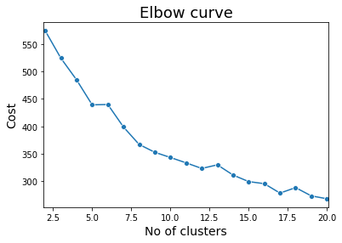
Algorithmic Optimization and Machine Learning
K-Prototypes algorithm is designed for clustering on mixed data.
Uses Euclidean distance for numeric, matching categories for categoric, and automatically finds relative importance.
However, we need to tell it how many cluster centroids to find – hyperparameter.
Manually tuned this hyperparameter through elbow curve.

Slide 19
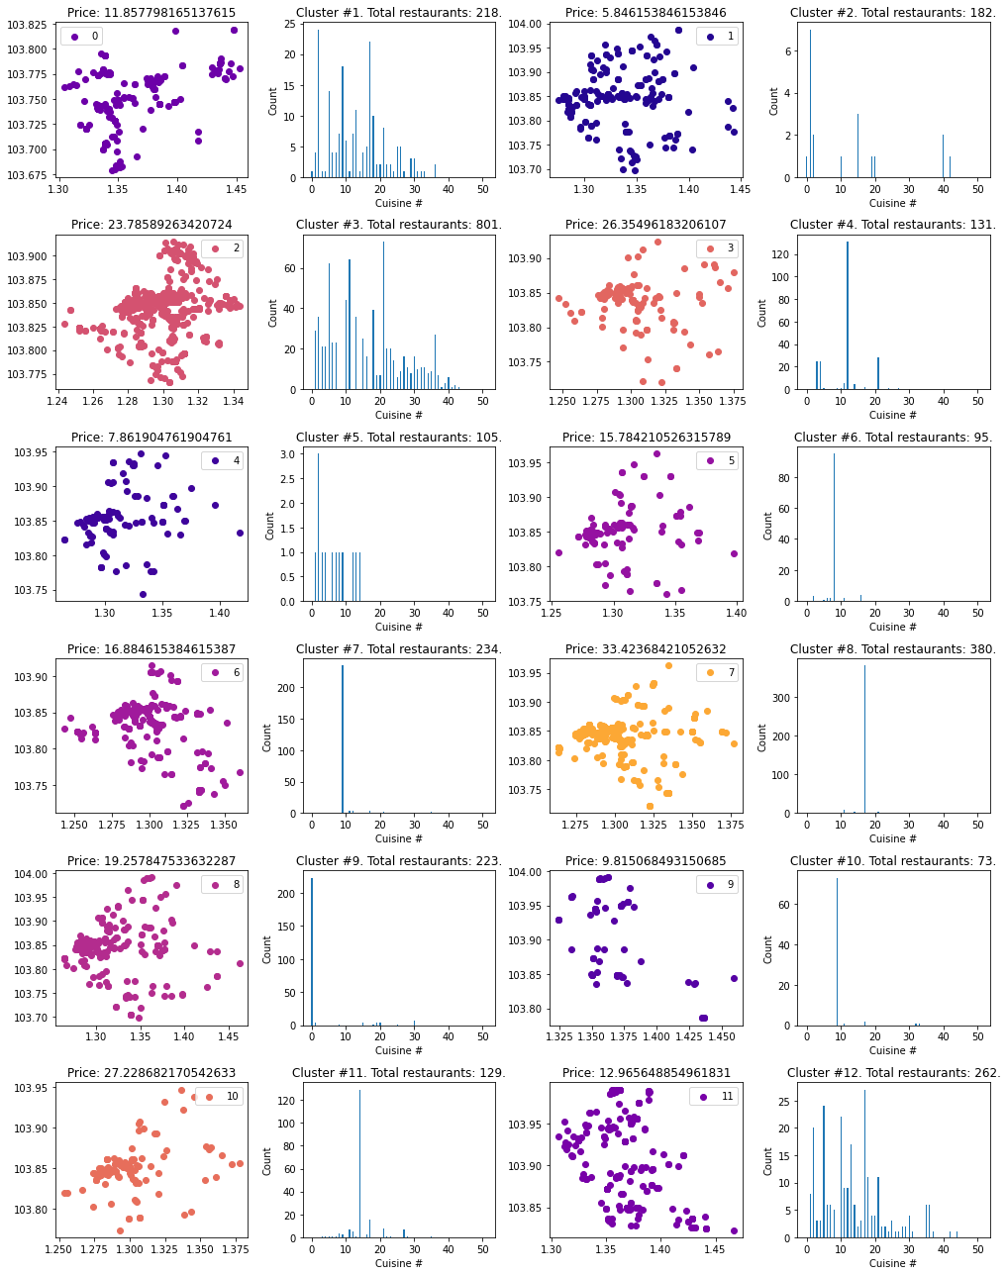
Model Visualisation & Evaluation
First tried visualising in combined chart.
Seems like clusters distinct, but hard to see confidently in such a complex chart.
Something better needed.

Slide 20
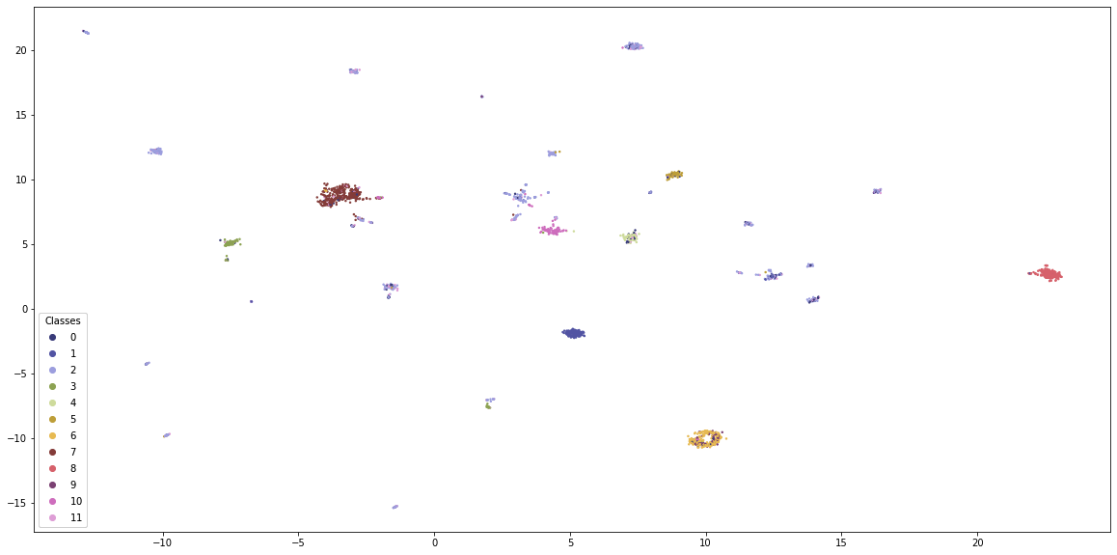
Model Visualisation & Evaluation
Applied dimensionality reduction using UMAP technique.
Used distance metric of K-Prototypes.
All rows in data reduced to points in 2d plane, then coloured according to cluster labels.
Success! Visually distinct clusters.

Slide 21
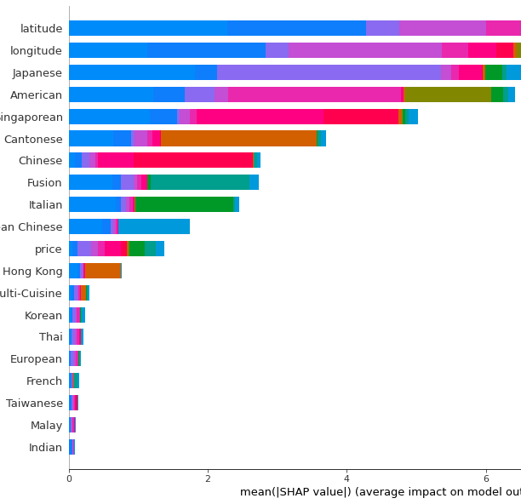
Model Visualisation & Evaluation
Still needed quantitative evaluation.
Trained classifier to predict K-Prototypes cluster labels.
Very high cross-validation F1 score (0.98) – distinct clusters.
Visualised SHAP feature importances.
Location, eight of the cuisines and price are most important.

Slide 22
Model Application
Goal: Novel yet familiar recommendations.
What we tried first
Pick three clusters furthest away from user’s visited restaurants.
Within those clusters, pick closest restaurants.
Cap user history length and decrease importance of older visits, to avoid getting “stuck” and having new restaurant visits not change user suggestions.

Slide 23
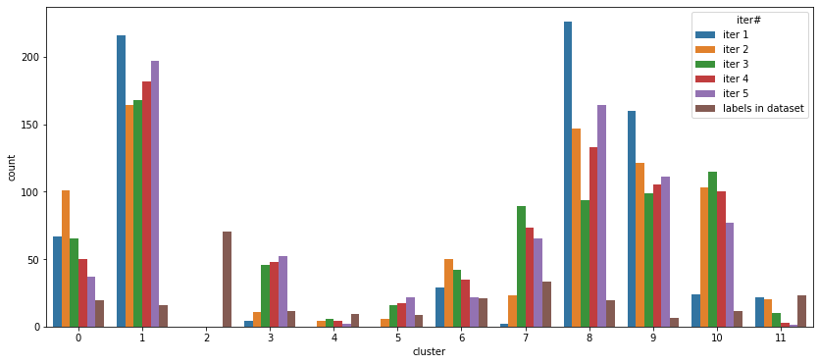
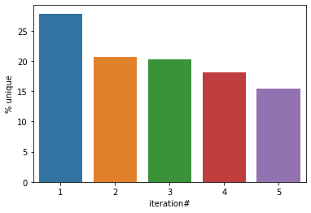
Model Application
How to judge how well it works? Variedness of recommendation with regards to the cluster they fall in, and uniqueness of the restaurants we recommend across the set of users. Result
Our model did not work well (yet)!
Not only did the metrics not start out good, they didn’t reliable get better as users visited more restaurants and grew our knowledge of their history.

Slide 24


Model application
Why wasn’t it working well?
Data-driven insight:
Looking back at our UMAP and comparing it to our chart of distribution of recommendations across clusters, seems like it’s biased towards clusters on average far away from all the other clusters. Obvious in hindsight…

Slide 25
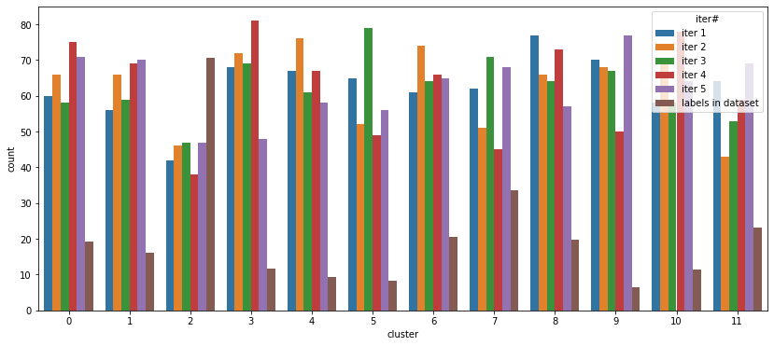
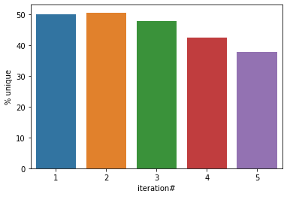
Model Application
Data-Driven Improvement:
Our clustering model already finds clusters which are very distinct from each other.
We don’t need to do the process of finding “furthest away” clusters from user’s history.
Randomly picking any cluster they haven’t been to is still an “important difference” to their past experience.
Did it work? Yes!
Variedness greatly improved, and uniqueness doubled, although it still shows somewhat of a downwards trend with growing history.

Slide 26
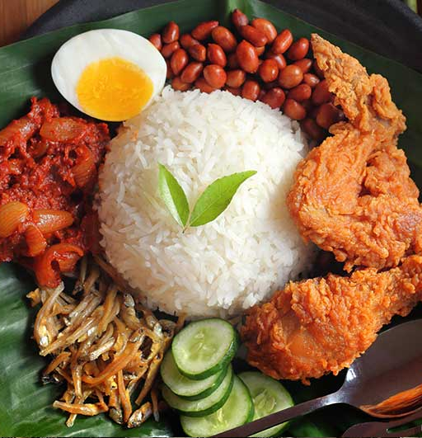
Conclusion
The system we came up with in the end fitting our problem statement works decently well.
Would likely be outperformed by systems leveraging collaborative filtering using large records of real user behaviour, but that’s unavoidable; we worked with the data we had.
Insight/Recommendation: Avoid duplication of efforts. After K-Prototypes clustering already found the “important difference”, putting another layer of “farthest cluster” on top just pigeonholed our results.

Slide 27
Thank you!

